Slide 1
Overall Regulations

Slide 2

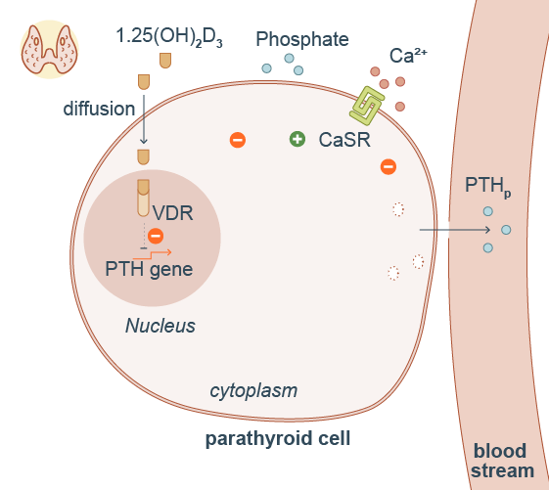
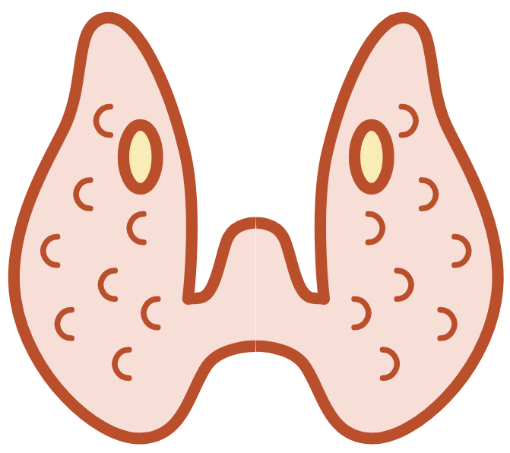


Parathyroid hormone is synthetized in parathyroid glands
parathyroid gland
PTH exocytosis is modulated by the calcium sensing receptor (CaSR)
PTHg
exocytosis
synthesis
degradation
Thyroid gland
Parathyroid hormone synthesis is regulated by 1,25 vitamin D3 and phosphate
A part of PTH is degraded inside the cell

Slide 3
Hypercalcemia inhibits PTH secretion

Slide 4
hypercalcemia
PTHg
exocytosis
synthesis
degradation
Hypercalcemia decreases PTH secretion

Slide 5
Hypocalcemia stimulates PTH secretion

Slide 6
hypocalcemia
PTHg
exocytosis
synthesis
degradation
Hypocalcemia increases PTH secretion

Slide 8
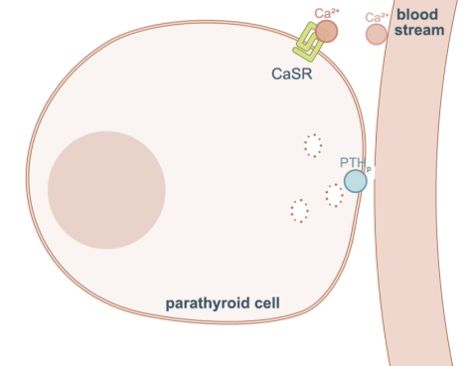

(4) Blinking arrow to show the modulation of CaSR which is the most important thing of this animation
(1) First zoom here
+/-
No need to show PTH mRNA here
(2) Remove phosphate everywhere
-
(3) Vitamin D3 should not
go outside the nucleus
PTH mRNA

